Slide 1







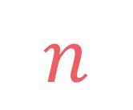

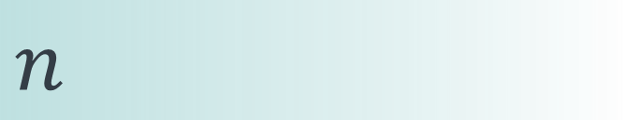

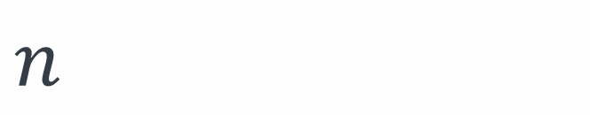
left
[4, 5, 1, 7, 2, 6, 3, 8]
no margin
Space complexity:
$$O(n)$$
list
list
list
list
mid
no margin
"string"
4 | 5 | 1 | 7 | 2 | 6 | 3 | 8
Space complexity:
$$O(n)$$
5
5
$
5
rec(n)
$$n$$
5
$$n$$
$$⇒$$
$$n$$
Time complexity:
$$O(n)$$
text
text
 |  |  | a
$$n$$
text
text
no margin
no margin
no margin
no margin
no margin
no margin
no margin
no margin

Slide 2

Coin change

Slide 3
Given an amount of money and a set of coins, find the minimum number of coins to make that amount (return -1 if it's not possible to do so)

Slide 4


input:
amount = 15
possible_coins
= [2, 3, 7]
output: 4
explanation:
7+3+3+2 = 15
2
3
3
7
15

Slide 5
input:
amount = 80
possible_coins = [1, 20, 25]
Greedy method returns 8: 25+25+25+1+1+1+1+1 = 80
Minimum number of coins is 4: 20+20+20+20 = 80

Slide 6
input:
amount = 15
possible_coins = [2, 3, 7]
coins(13)
+
2
coins(12)
+
3
coins(15)
+
7
coins(8)

Slide 7
input:
amount = 15
possible_coins = [2, 3, 7]
coins(13)
+
2
coins(12)
+
3
coins(15)
+
7
coins(8)
coins(15) = 1 + min(coins(13), coins(12), coins(8))

Slide 8



$$coins\left(amount\right)=1+\min_{\begin{aligned}coin∈ \\ possible_co\end{aligned}}{coins(amount−coin)}$$
$$coin∈$$
$possible_coins$,
$$coin≤amount$$

Slide 9

Coin change:
amount
possible coins
Ways to climb:
n
possible jumps

Slide 10

Coin change:
Ways to climb:
input:
amount = 15
possible_coins = [2, 3, 7]
input:
n = 15
jumps = [2, 3, 7]
Coins:
Jumps:
7
7
7
7
3
3
3
3
3
3
2
2
2
2

Slide 11

Coin change:
Ways to climb:
input:
amount = 15
possible_coins = [2, 3, 7]
input:
n = 15
jumps = [2, 3, 7]
Coins:
Jumps:
7
7
7
7
3
3
3
3
3
3
2
2
2
2

Slide 12
Coin change:
Ways to climb:
input:
amount = 15
possible_coins = [2, 3, 7]
input:
n = 15
jumps = [2, 3, 7]
Coins:
Jumps:
7
7
7
7
2
2
3
3
3
3
3
3
2
2

Slide 13
Coin change:
Ways to climb:
input:
amount = 15
possible_coins = [2, 3, 7]
input:
n = 15
jumps = [2, 3, 7]
Coins:
Jumps:
3
3
7
7
7
7
2
2
3
3
3
3
2
2

Slide 14
Coin change:
Ways to climb:
input:
amount = 15
possible_coins = [2, 3, 7]
input:
n = 15
jumps = [2, 3, 7]
7
7
Coins:
Jumps:
3
3
7
7
2
2
3
3
3
3
2
2

Slide 15
Coin change:
Ways to climb:
input:
amount = 15
possible_coins = [2, 3, 7]
input:
n = 15
jumps = [2, 3, 7]
7
7
Coins:
Jumps:
amount
3
n
3
7
7
2
2
3
3
3
3
2
2

Slide 16



Water bucket:
Ways to climb:
input:
bucket = 15
glasses = [2, 3, 7]
input:
n = 15
jumps = [2, 3, 7]
7
7
Glasses:
Jumps:
bucket
3
n
3
7
7
2
2
3
3
3
3
2
2

Slide 17






Coin change:
Ways to climb:
We want to find the length of the smallest set $S$ that satisfies:
We want to find the total number of sets $S$ that satisfy:
$$S⊆possible_coins$$
$$S⊆jumps$$
$$\sum_{c∈S}{c=amount}$$
$$\sum_{c∈S}{c=n}$$
and
and

Slide 18
$$coins\left(amount\right)=1+\min_{\begin{aligned}coin∈ \\ possible_co\end{aligned}}{coins(amount−coin)}$$
$$coin∈$$
$possible_coins$,
$$coin≤amount$$

Slide 19








$$0$$
$$if amount=0$$
$$coins\left(amount\right)=$$
$$1+\min_{\begin{aligned}coin∈ \\ possible_co\end{aligned}}{coins(amount−coin)}$$
$$otherwise$$
$$coin∈$$
$possible_coins$,
$$coin≤amount$$

Slide 20








def coins(amount, possible_coins): def _coins(amount, possible_coins): if amount == 0: return 0 else: min_coins = float("inf") for coin in possible_coins: if (amount-coin) >= 0: min_coins = min(min_coins, 1+_coins(amount-coin, possible_coins)) return min_coins min_coins = _coins(amount, possible_coins) return -1 if min_coins == float("inf") else min_coins
$$0$$
$$if amount=0$$
$$coins\left(amount\right)=$$
$$1+\min_{\begin{aligned}coin∈ \\ possible_co\end{aligned}}{coins(amount−coin)}$$
$$otherwise$$
$$coin∈$$
$possible_coins$,
$$coin≤amount$$

Slide 21
def coins(amount, possible_coins): def _coins(amount, possible_coins): if amount == 0: return 0 else: min_coins = float("inf") for coin in possible_coins: if (amount-coin) >= 0: min_coins = min(min_coins, 1+_coins(amount-coin, possible_coins)) return min_coins min_coins = _coins(amount, possible_coins) return -1 if min_coins == float("inf") else min_coins
$$0$$
$$if amount=0$$
$$coins\left(amount\right)=$$
$$1+\min_{\begin{aligned}coin∈ \\ possible_co\end{aligned}}{coins(amount−coin)}$$
$$otherwise$$
$$coin∈$$
$possible_coins$,
$$coin≤amount$$

Slide 22

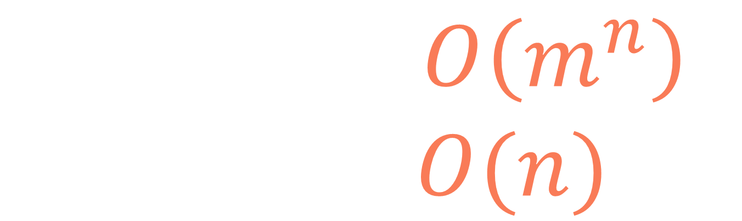
$$n:\text{amount} \\ m:|\text{possible}\text{_}\text{coins}|$$
$$T\left(n,m\right)=O\left(m^{n}\right) \\ S\left(n,m\right)=O(n)$$

Slide 23
input:
amount = 15
possible_coins = [2, 3, 7]
coins
(15)
coins
(13)
coins
(12)
coins
(11)
coins
(10)
coins
(9)
coins
(8)
coins
(7)
coins
(6)
coins
(5)
coins
(4)
coins
(3)
coins
(2)
coins
(1)
coins
(0)

Slide 24
input:
amount = 15
possible_coins = [2, 3, 7]
coins
(15)
coins
(13)
coins
(12)
coins
(11)
coins
(10)
coins
(9)
coins
(8)
coins
(7)
coins
(6)
coins
(5)
coins
(4)
coins
(3)
coins
(2)
coins
(1)
coins
(0)

Slide 25
def coins(amount, possible_coins): def _coins(amount, possible_coins, lookup=None): lookup = {} if lookup is None else lookup if amount in lookup: return lookup[amount] if amount == 0: return 0 else: min_coins = float("inf") for coin in possible_coins: if (amount-coin) >= 0: min_coins = min(min_coins,
1+_coins(amount-coin, possible_coins, lookup)) lookup[amount] = min_coins return lookup[amount] min_coins = _coins(amount, possible_coins) return -1 if min_coins == float("inf") else min_coins
1
2
3
4

Slide 26
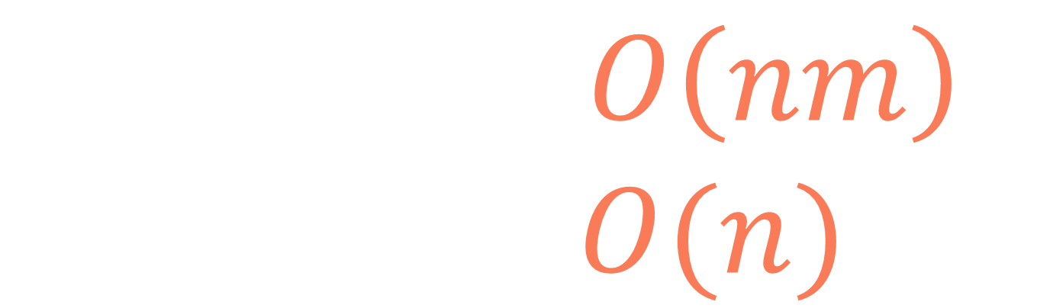
$$n:\text{amount} \\ m:|\text{possible}\text{_}\text{coins}|$$
$$T\left(n,m\right)=O\left(nm\right) \\ S\left(n,m\right)=O(n)$$

Slide 27
def coins(amount, possible_coins): dp = [float("inf")]*(amount+1) dp[0] = 0 for i in range(1, amount+1): for coin in possible_coins: if (i-coin) >= 0: dp[i] = min(dp[i], 1+dp[i-coin]) return -1 if dp[amount] == float("inf") else dp[amount]

Slide 28
def coins(amount, possible_coins): dp = [float("inf")]*(amount+1) dp[0] = 0 for i in range(1, amount+1): for coin in possible_coins: if (i-coin) >= 0: dp[i] = min(dp[i], 1+dp[i-coin]) return -1 if dp[amount] == float("inf") else dp[amount]

Slide 29
def coins(amount, possible_coins): dp = [float("inf")]*(amount+1) dp[0] = 0 for i in range(1, amount+1): for coin in possible_coins: if (i-coin) >= 0: dp[i] = min(dp[i], 1+dp[i-coin]) return -1 if dp[amount] == float("inf") else dp[amount]

Slide 30
def coins(amount, possible_coins): dp = [float("inf")]*(amount+1) dp[0] = 0 for i in range(1, amount+1): for coin in possible_coins: if (i-coin) >= 0: dp[i] = min(dp[i], 1+dp[i-coin]) return -1 if dp[amount] == float("inf") else dp[amount]

Slide 31
input:
amount = 15
possible_coins = [2, 3, 7]
dp
∞
∞
∞
∞
∞
∞
∞
∞
∞
∞
∞
∞
∞
∞
∞
∞
def coins(amount, possible_coins): dp = [float("inf")]*(amount+1) dp[0] = 0 for i in range(1, amount+1): for coin in possible_coins: if (i-coin) >= 0: dp[i] = min(dp[i], 1+dp[i-coin]) return -1 if dp[amount] == float("inf") else dp[amount]

Slide 32
input:
amount = 15
possible_coins = [2, 3, 7]
dp
0
∞
∞
∞
∞
∞
∞
∞
∞
∞
∞
∞
∞
∞
∞
∞
def coins(amount, possible_coins): dp = [float("inf")]*(amount+1) dp[0] = 0 for i in range(1, amount+1): for coin in possible_coins: if (i-coin) >= 0: dp[i] = min(dp[i], 1+dp[i-coin]) return -1 if dp[amount] == float("inf") else dp[amount]

Slide 33
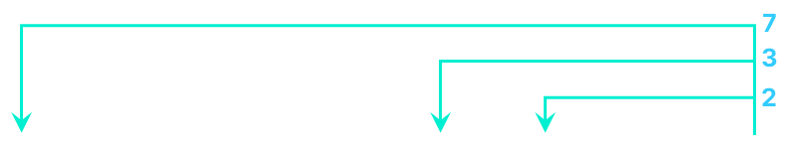
input:
amount = 15
possible_coins = [2, 3, 7]
dp
0
∞
∞
∞
∞
∞
∞
∞
∞
∞
∞
∞
∞
∞
∞
∞
def coins(amount, possible_coins): dp = [float("inf")]*(amount+1) dp[0] = 0 for i in range(1, amount+1): for coin in possible_coins: if (i-coin) >= 0: dp[i] = min(dp[i], 1+dp[i-coin]) return -1 if dp[amount] == float("inf") else dp[amount]

Slide 34
input:
amount = 15
possible_coins = [2, 3, 7]
dp
0
∞
∞
∞
∞
∞
∞
∞
∞
∞
∞
∞
∞
∞
∞
∞
def coins(amount, possible_coins): dp = [float("inf")]*(amount+1) dp[0] = 0 for i in range(1, amount+1): for coin in possible_coins: if (i-coin) >= 0: dp[i] = min(dp[i], 1+dp[i-coin]) return -1 if dp[amount] == float("inf") else dp[amount]

Slide 35
input:
amount = 15
possible_coins = [2, 3, 7]
dp
0
∞
1
∞
∞
∞
∞
∞
∞
∞
∞
∞
∞
∞
∞
∞
def coins(amount, possible_coins): dp = [float("inf")]*(amount+1) dp[0] = 0 for i in range(1, amount+1): for coin in possible_coins: if (i-coin) >= 0: dp[i] = min(dp[i], 1+dp[i-coin]) return -1 if dp[amount] == float("inf") else dp[amount]

Slide 36
input:
amount = 15
possible_coins = [2, 3, 7]
dp
0
∞
1
∞
∞
∞
∞
∞
∞
∞
∞
∞
∞
∞
∞
∞
def coins(amount, possible_coins): dp = [float("inf")]*(amount+1) dp[0] = 0 for i in range(1, amount+1): for coin in possible_coins: if (i-coin) >= 0: dp[i] = min(dp[i], 1+dp[i-coin]) return -1 if dp[amount] == float("inf") else dp[amount]

Slide 37
input:
amount = 15
possible_coins = [2, 3, 7]
dp
0
∞
1
1
∞
∞
∞
∞
∞
∞
∞
∞
∞
∞
∞
∞
def coins(amount, possible_coins): dp = [float("inf")]*(amount+1) dp[0] = 0 for i in range(1, amount+1): for coin in possible_coins: if (i-coin) >= 0: dp[i] = min(dp[i], 1+dp[i-coin]) return -1 if dp[amount] == float("inf") else dp[amount]

Slide 38
input:
amount = 15
possible_coins = [2, 3, 7]
dp
0
∞
1
1
∞
∞
∞
∞
∞
∞
∞
∞
∞
∞
∞
∞
def coins(amount, possible_coins): dp = [float("inf")]*(amount+1) dp[0] = 0 for i in range(1, amount+1): for coin in possible_coins: if (i-coin) >= 0: dp[i] = min(dp[i], 1+dp[i-coin]) return -1 if dp[amount] == float("inf") else dp[amount]

Slide 39
input:
amount = 15
possible_coins = [2, 3, 7]
dp
0
∞
1
1
2
∞
∞
∞
∞
∞
∞
∞
∞
∞
∞
∞
def coins(amount, possible_coins): dp = [float("inf")]*(amount+1) dp[0] = 0 for i in range(1, amount+1): for coin in possible_coins: if (i-coin) >= 0: dp[i] = min(dp[i], 1+dp[i-coin]) return -1 if dp[amount] == float("inf") else dp[amount]

Slide 40
input:
amount = 15
possible_coins = [2, 3, 7]
dp
0
∞
1
1
2
∞
∞
∞
∞
∞
∞
∞
∞
∞
∞
∞
def coins(amount, possible_coins): dp = [float("inf")]*(amount+1) dp[0] = 0 for i in range(1, amount+1): for coin in possible_coins: if (i-coin) >= 0: dp[i] = min(dp[i], 1+dp[i-coin]) return -1 if dp[amount] == float("inf") else dp[amount]

Slide 41
input:
amount = 15
possible_coins = [2, 3, 7]
dp
0
∞
1
1
2
2
∞
∞
∞
∞
∞
∞
∞
∞
∞
∞
def coins(amount, possible_coins): dp = [float("inf")]*(amount+1) dp[0] = 0 for i in range(1, amount+1): for coin in possible_coins: if (i-coin) >= 0: dp[i] = min(dp[i], 1+dp[i-coin]) return -1 if dp[amount] == float("inf") else dp[amount]

Slide 42
input:
amount = 15
possible_coins = [2, 3, 7]
dp
0
∞
1
1
2
2
∞
∞
∞
∞
∞
∞
∞
∞
∞
∞
def coins(amount, possible_coins): dp = [float("inf")]*(amount+1) dp[0] = 0 for i in range(1, amount+1): for coin in possible_coins: if (i-coin) >= 0: dp[i] = min(dp[i], 1+dp[i-coin]) return -1 if dp[amount] == float("inf") else dp[amount]

Slide 43
input:
amount = 15
possible_coins = [2, 3, 7]
dp
0
∞
1
1
2
2
2
∞
∞
∞
∞
∞
∞
∞
∞
∞
def coins(amount, possible_coins): dp = [float("inf")]*(amount+1) dp[0] = 0 for i in range(1, amount+1): for coin in possible_coins: if (i-coin) >= 0: dp[i] = min(dp[i], 1+dp[i-coin]) return -1 if dp[amount] == float("inf") else dp[amount]

Slide 44
input:
amount = 15
possible_coins = [2, 3, 7]
dp
0
∞
1
1
2
2
2
∞
∞
∞
∞
∞
∞
∞
∞
∞
def coins(amount, possible_coins): dp = [float("inf")]*(amount+1) dp[0] = 0 for i in range(1, amount+1): for coin in possible_coins: if (i-coin) >= 0: dp[i] = min(dp[i], 1+dp[i-coin]) return -1 if dp[amount] == float("inf") else dp[amount]

Slide 45
input:
amount = 15
possible_coins = [2, 3, 7]
dp
0
∞
1
1
2
2
2
1
∞
∞
∞
∞
∞
∞
∞
∞
def coins(amount, possible_coins): dp = [float("inf")]*(amount+1) dp[0] = 0 for i in range(1, amount+1): for coin in possible_coins: if (i-coin) >= 0: dp[i] = min(dp[i], 1+dp[i-coin]) return -1 if dp[amount] == float("inf") else dp[amount]

Slide 46
input:
amount = 15
possible_coins = [2, 3, 7]
dp
0
∞
1
1
2
2
2
1
∞
∞
∞
∞
∞
∞
∞
∞
def coins(amount, possible_coins): dp = [float("inf")]*(amount+1) dp[0] = 0 for i in range(1, amount+1): for coin in possible_coins: if (i-coin) >= 0: dp[i] = min(dp[i], 1+dp[i-coin]) return -1 if dp[amount] == float("inf") else dp[amount]

Slide 47
input:
amount = 15
possible_coins = [2, 3, 7]
dp
0
∞
1
1
2
2
2
1
3
∞
∞
∞
∞
∞
∞
∞
def coins(amount, possible_coins): dp = [float("inf")]*(amount+1) dp[0] = 0 for i in range(1, amount+1): for coin in possible_coins: if (i-coin) >= 0: dp[i] = min(dp[i], 1+dp[i-coin]) return -1 if dp[amount] == float("inf") else dp[amount]

Slide 48
input:
amount = 15
possible_coins = [2, 3, 7]
dp
0
∞
1
1
2
2
2
1
3
∞
∞
∞
∞
∞
∞
∞
def coins(amount, possible_coins): dp = [float("inf")]*(amount+1) dp[0] = 0 for i in range(1, amount+1): for coin in possible_coins: if (i-coin) >= 0: dp[i] = min(dp[i], 1+dp[i-coin]) return -1 if dp[amount] == float("inf") else dp[amount]

Slide 49
input:
amount = 15
possible_coins = [2, 3, 7]
dp
0
∞
1
1
2
2
2
1
3
2
∞
∞
∞
∞
∞
∞
def coins(amount, possible_coins): dp = [float("inf")]*(amount+1) dp[0] = 0 for i in range(1, amount+1): for coin in possible_coins: if (i-coin) >= 0: dp[i] = min(dp[i], 1+dp[i-coin]) return -1 if dp[amount] == float("inf") else dp[amount]

Slide 50
input:
amount = 15
possible_coins = [2, 3, 7]
dp
0
∞
1
1
2
2
2
1
3
2
∞
∞
∞
∞
∞
∞
def coins(amount, possible_coins): dp = [float("inf")]*(amount+1) dp[0] = 0 for i in range(1, amount+1): for coin in possible_coins: if (i-coin) >= 0: dp[i] = min(dp[i], 1+dp[i-coin]) return -1 if dp[amount] == float("inf") else dp[amount]

Slide 51
input:
amount = 15
possible_coins = [2, 3, 7]
dp
0
∞
1
1
2
2
2
1
3
2
2
∞
∞
∞
∞
∞
def coins(amount, possible_coins): dp = [float("inf")]*(amount+1) dp[0] = 0 for i in range(1, amount+1): for coin in possible_coins: if (i-coin) >= 0: dp[i] = min(dp[i], 1+dp[i-coin]) return -1 if dp[amount] == float("inf") else dp[amount]

Slide 52
input:
amount = 15
possible_coins = [2, 3, 7]
dp
0
∞
1
1
2
2
2
1
3
2
2
∞
∞
∞
∞
∞
def coins(amount, possible_coins): dp = [float("inf")]*(amount+1) dp[0] = 0 for i in range(1, amount+1): for coin in possible_coins: if (i-coin) >= 0: dp[i] = min(dp[i], 1+dp[i-coin]) return -1 if dp[amount] == float("inf") else dp[amount]

Slide 53
input:
amount = 15
possible_coins = [2, 3, 7]
dp
0
∞
1
1
2
2
2
1
3
2
2
3
∞
∞
∞
∞
def coins(amount, possible_coins): dp = [float("inf")]*(amount+1) dp[0] = 0 for i in range(1, amount+1): for coin in possible_coins: if (i-coin) >= 0: dp[i] = min(dp[i], 1+dp[i-coin]) return -1 if dp[amount] == float("inf") else dp[amount]

Slide 54
input:
amount = 15
possible_coins = [2, 3, 7]
dp
0
∞
1
1
2
2
2
1
3
2
2
3
∞
∞
∞
∞
def coins(amount, possible_coins): dp = [float("inf")]*(amount+1) dp[0] = 0 for i in range(1, amount+1): for coin in possible_coins: if (i-coin) >= 0: dp[i] = min(dp[i], 1+dp[i-coin]) return -1 if dp[amount] == float("inf") else dp[amount]

Slide 55
input:
amount = 15
possible_coins = [2, 3, 7]
dp
0
∞
1
1
2
2
2
1
3
2
2
3
3
∞
∞
∞
def coins(amount, possible_coins): dp = [float("inf")]*(amount+1) dp[0] = 0 for i in range(1, amount+1): for coin in possible_coins: if (i-coin) >= 0: dp[i] = min(dp[i], 1+dp[i-coin]) return -1 if dp[amount] == float("inf") else dp[amount]

Slide 56
input:
amount = 15
possible_coins = [2, 3, 7]
dp
0
∞
1
1
2
2
2
1
3
2
2
3
3
∞
∞
∞
def coins(amount, possible_coins): dp = [float("inf")]*(amount+1) dp[0] = 0 for i in range(1, amount+1): for coin in possible_coins: if (i-coin) >= 0: dp[i] = min(dp[i], 1+dp[i-coin]) return -1 if dp[amount] == float("inf") else dp[amount]

Slide 57
input:
amount = 15
possible_coins = [2, 3, 7]
dp
0
∞
1
1
2
2
2
1
3
2
2
3
3
3
∞
∞
def coins(amount, possible_coins): dp = [float("inf")]*(amount+1) dp[0] = 0 for i in range(1, amount+1): for coin in possible_coins: if (i-coin) >= 0: dp[i] = min(dp[i], 1+dp[i-coin]) return -1 if dp[amount] == float("inf") else dp[amount]

Slide 58
input:
amount = 15
possible_coins = [2, 3, 7]
dp
0
∞
1
1
2
2
2
1
3
2
2
3
3
3
∞
∞
def coins(amount, possible_coins): dp = [float("inf")]*(amount+1) dp[0] = 0 for i in range(1, amount+1): for coin in possible_coins: if (i-coin) >= 0: dp[i] = min(dp[i], 1+dp[i-coin]) return -1 if dp[amount] == float("inf") else dp[amount]

Slide 59
input:
amount = 15
possible_coins = [2, 3, 7]
dp
0
∞
1
1
2
2
2
1
3
2
2
3
3
3
2
∞
def coins(amount, possible_coins): dp = [float("inf")]*(amount+1) dp[0] = 0 for i in range(1, amount+1): for coin in possible_coins: if (i-coin) >= 0: dp[i] = min(dp[i], 1+dp[i-coin]) return -1 if dp[amount] == float("inf") else dp[amount]

Slide 60
input:
amount = 15
possible_coins = [2, 3, 7]
dp
0
∞
1
1
2
2
2
1
3
2
2
3
3
3
2
∞
def coins(amount, possible_coins): dp = [float("inf")]*(amount+1) dp[0] = 0 for i in range(1, amount+1): for coin in possible_coins: if (i-coin) >= 0: dp[i] = min(dp[i], 1+dp[i-coin]) return -1 if dp[amount] == float("inf") else dp[amount]

Slide 61
input:
amount = 15
possible_coins = [2, 3, 7]
dp
0
∞
1
1
2
2
2
1
3
2
2
3
3
3
2
4
def coins(amount, possible_coins): dp = [float("inf")]*(amount+1) dp[0] = 0 for i in range(1, amount+1): for coin in possible_coins: if (i-coin) >= 0: dp[i] = min(dp[i], 1+dp[i-coin]) return -1 if dp[amount] == float("inf") else dp[amount]

Slide 62
input:
amount = 15
possible_coins = [2, 3, 7]
dp
0
∞
1
1
2
2
2
1
3
2
2
3
3
3
2
4
def coins(amount, possible_coins): dp = [float("inf")]*(amount+1) dp[0] = 0 for i in range(1, amount+1): for coin in possible_coins: if (i-coin) >= 0: dp[i] = min(dp[i], 1+dp[i-coin]) return -1 if dp[amount] == float("inf") else dp[amount]

Slide 63
input:
amount = 15
possible_coins = [2, 3, 7]
+
+
+
+
2
3
3
7
dp
0
∞
1
1
2
2
2
1
3
2
2
3
3
3
2
4
def coins(amount, possible_coins): dp = [float("inf")]*(amount+1) dp[0] = 0 for i in range(1, amount+1): for coin in possible_coins: if (i-coin) >= 0: dp[i] = min(dp[i], 1+dp[i-coin]) return -1 if dp[amount] == float("inf") else dp[amount]

Slide 64
$$n:\text{amount} \\ m:|\text{possible}\text{_}\text{coins}|$$
$$T\left(n,m\right)=O\left(nm\right) \\ S\left(n,m\right)=O(n)$$

Slide 65
Coin change

